Slide 2
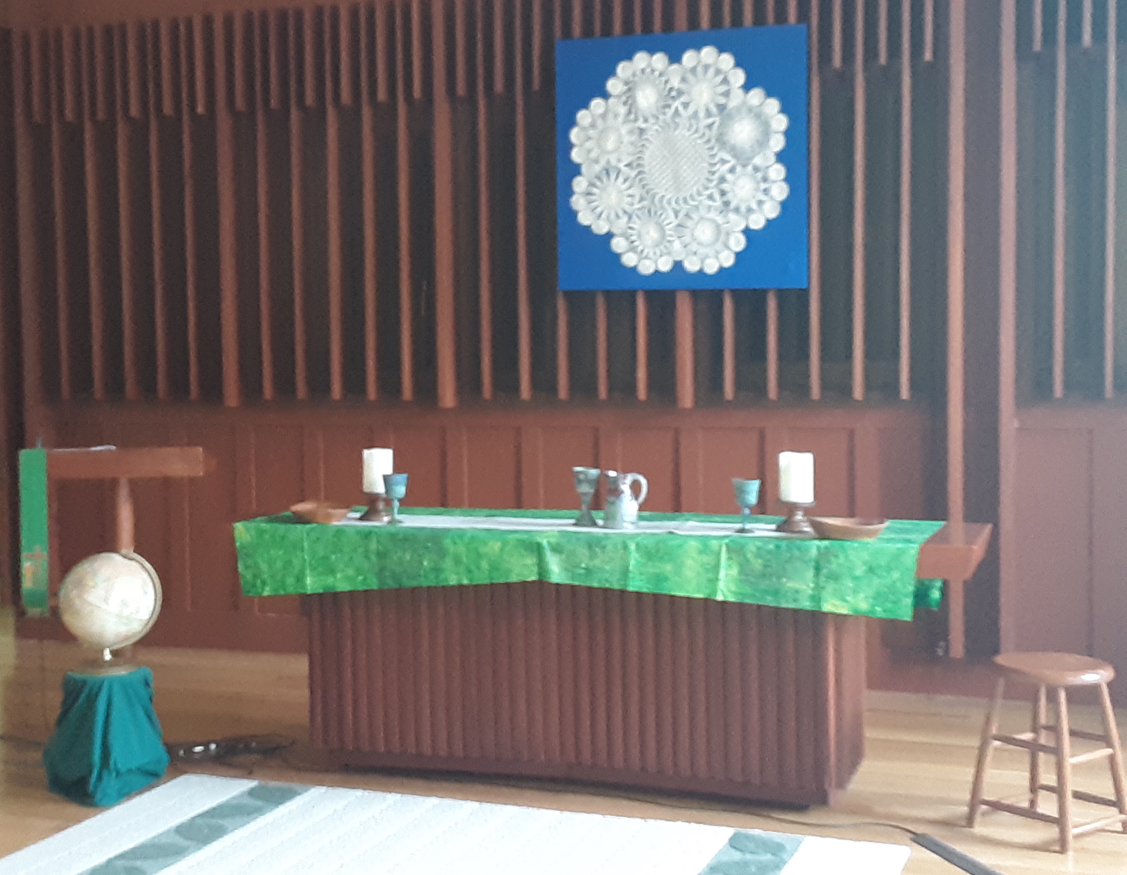
World Communion Sunday
FCC Communion Table
Bowls are from mission trip to Paraguay; green chalices from Israel (gift from Brooke Apple to SHMC); white cloth on table and pitcher/chalice from Ireland; wall hanging from Paraguay

Slide 3
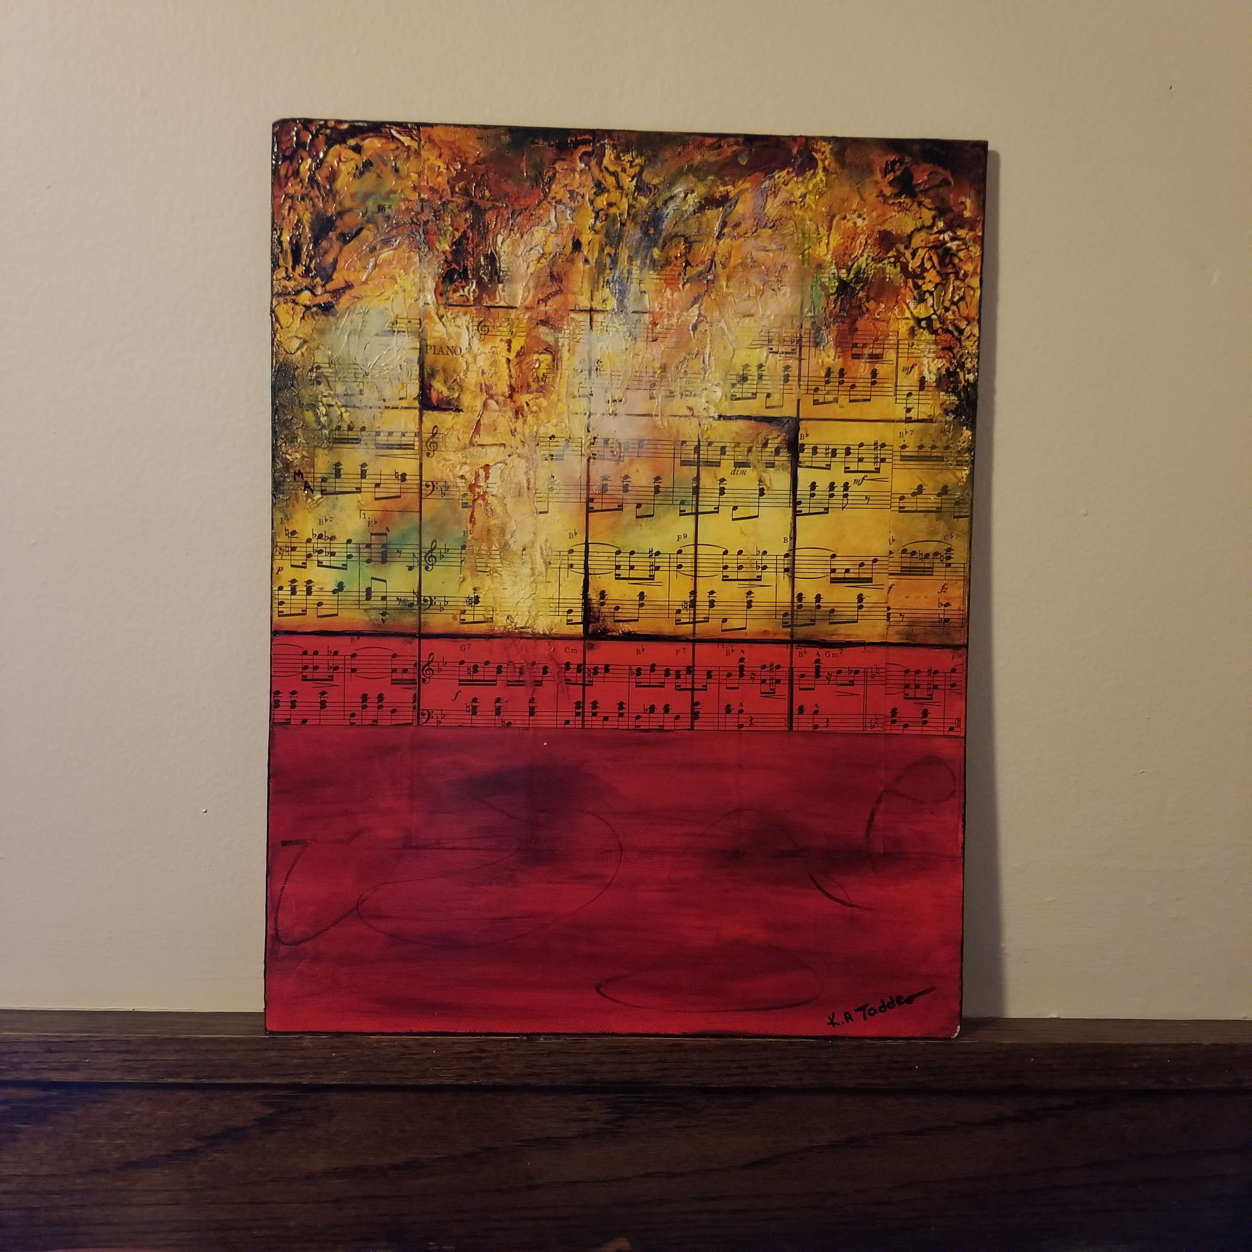
Crescendo II by Karen Taddeo
purchased by Bonnie F. in Sarasota, FL

Slide 4
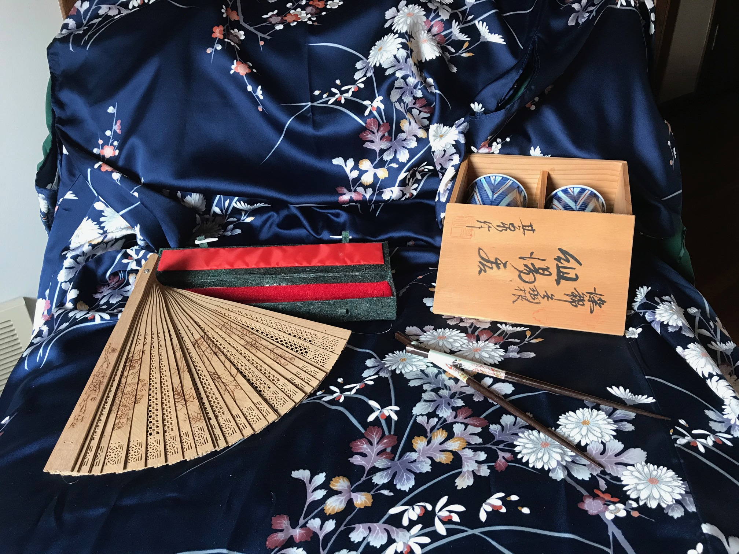
submitted by Ann W.

Slide 5
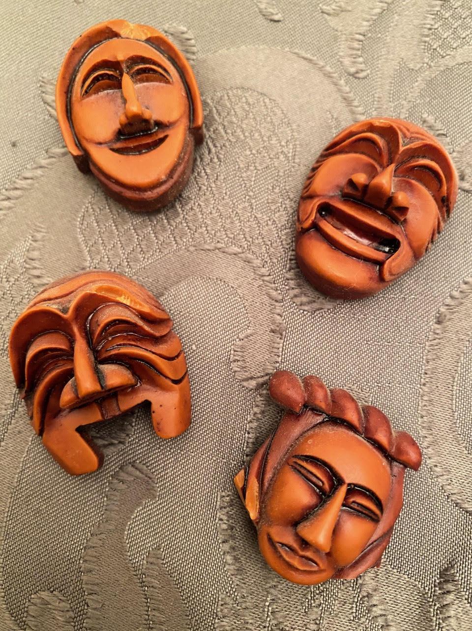
Magnets based on traditional Korean theater masks
purchased by Anna B. in Seoul, South Korean

Slide 6
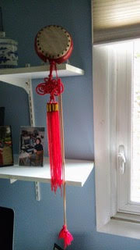
Fengyang Flower Drum
purchased by Martha H. in Fengyang, China

Slide 7
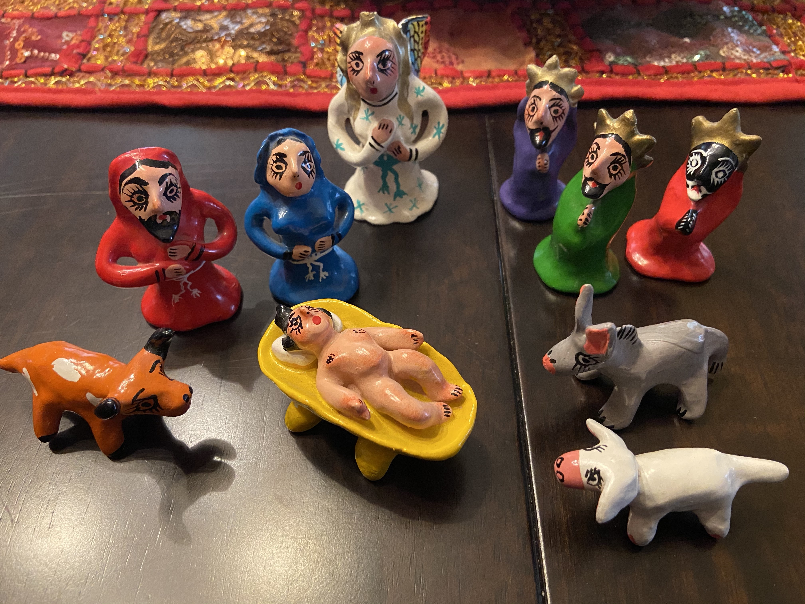
Mexican nativity set
purchased by Pastor Dan & Keith in Puerto Vallarta

Slide 8
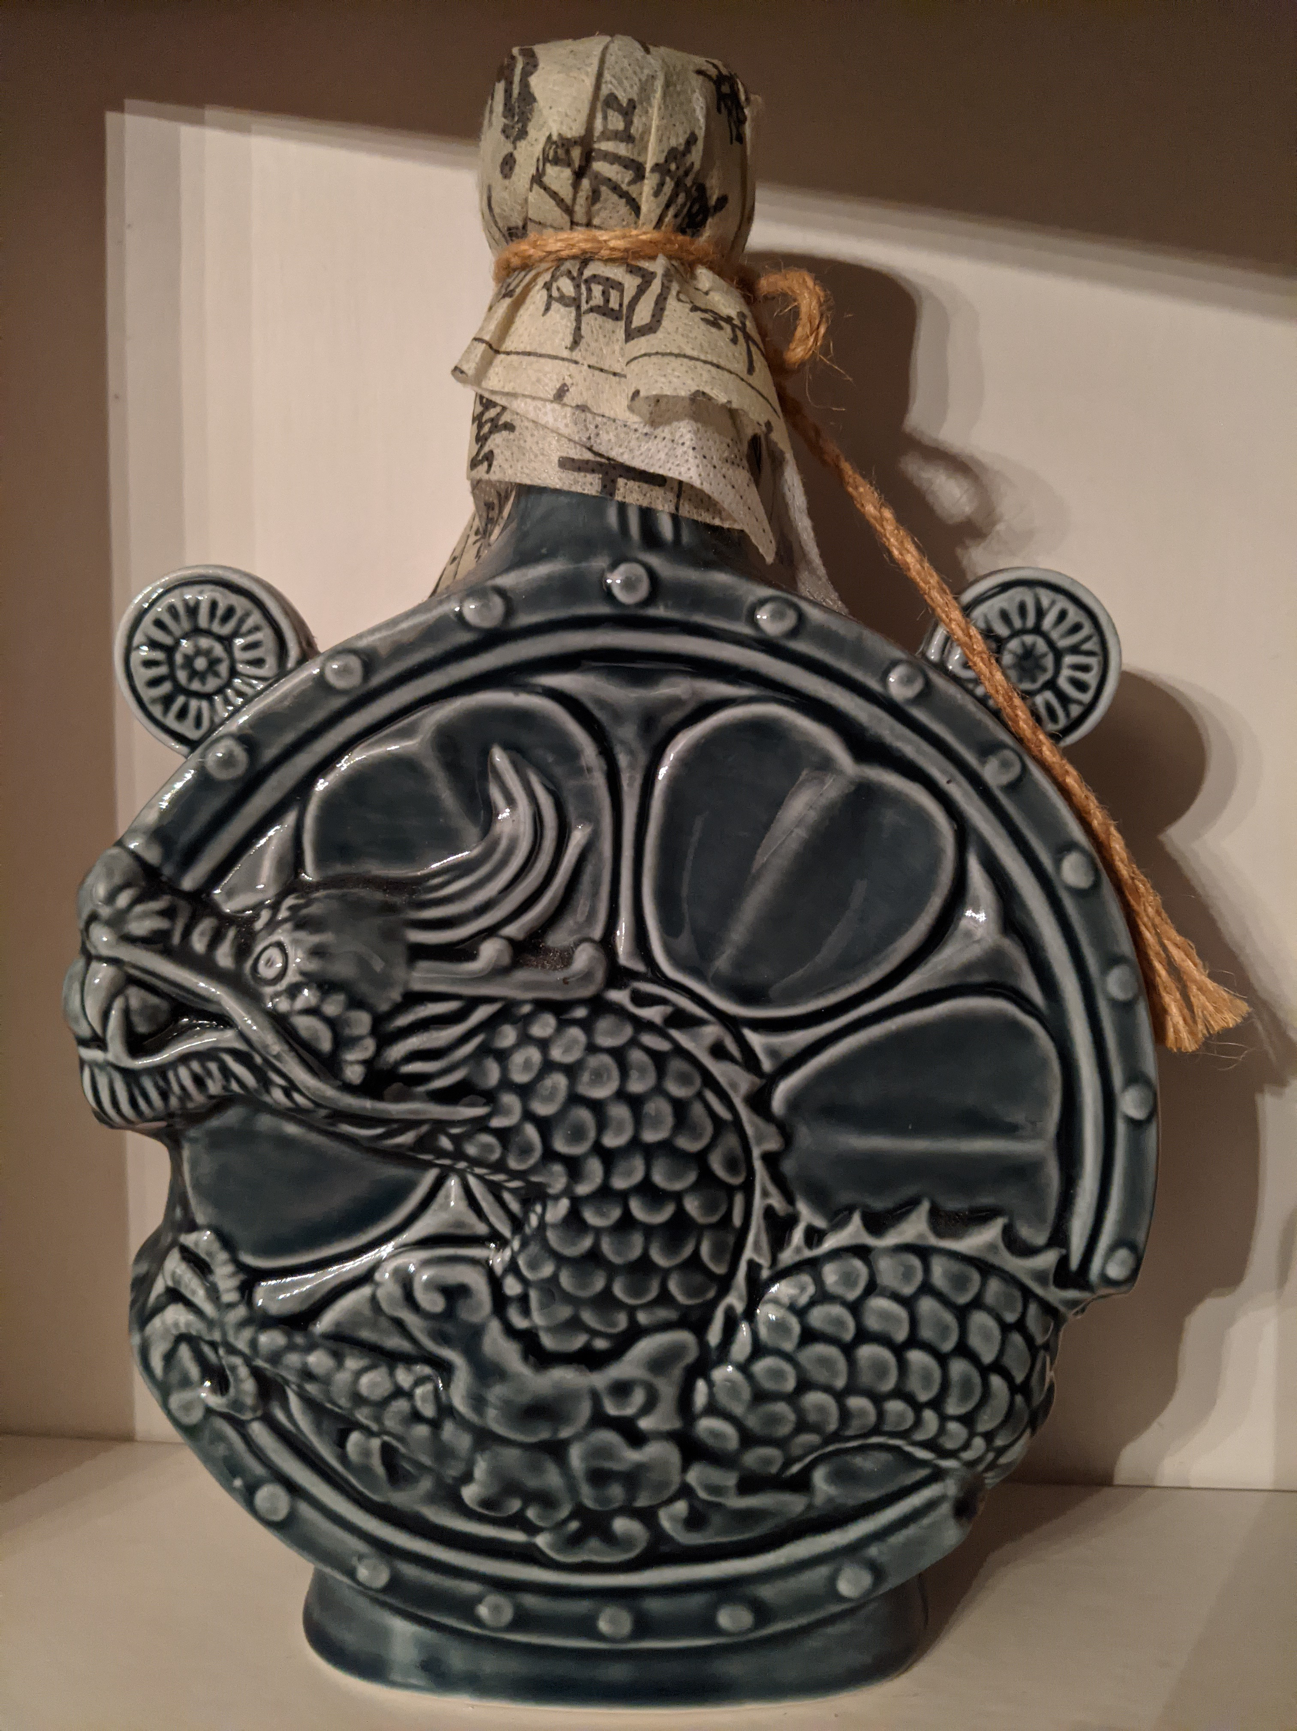
Korean bottle
received by Susan M. from her friend Jenny who was stationed in the DMZ

Slide 9
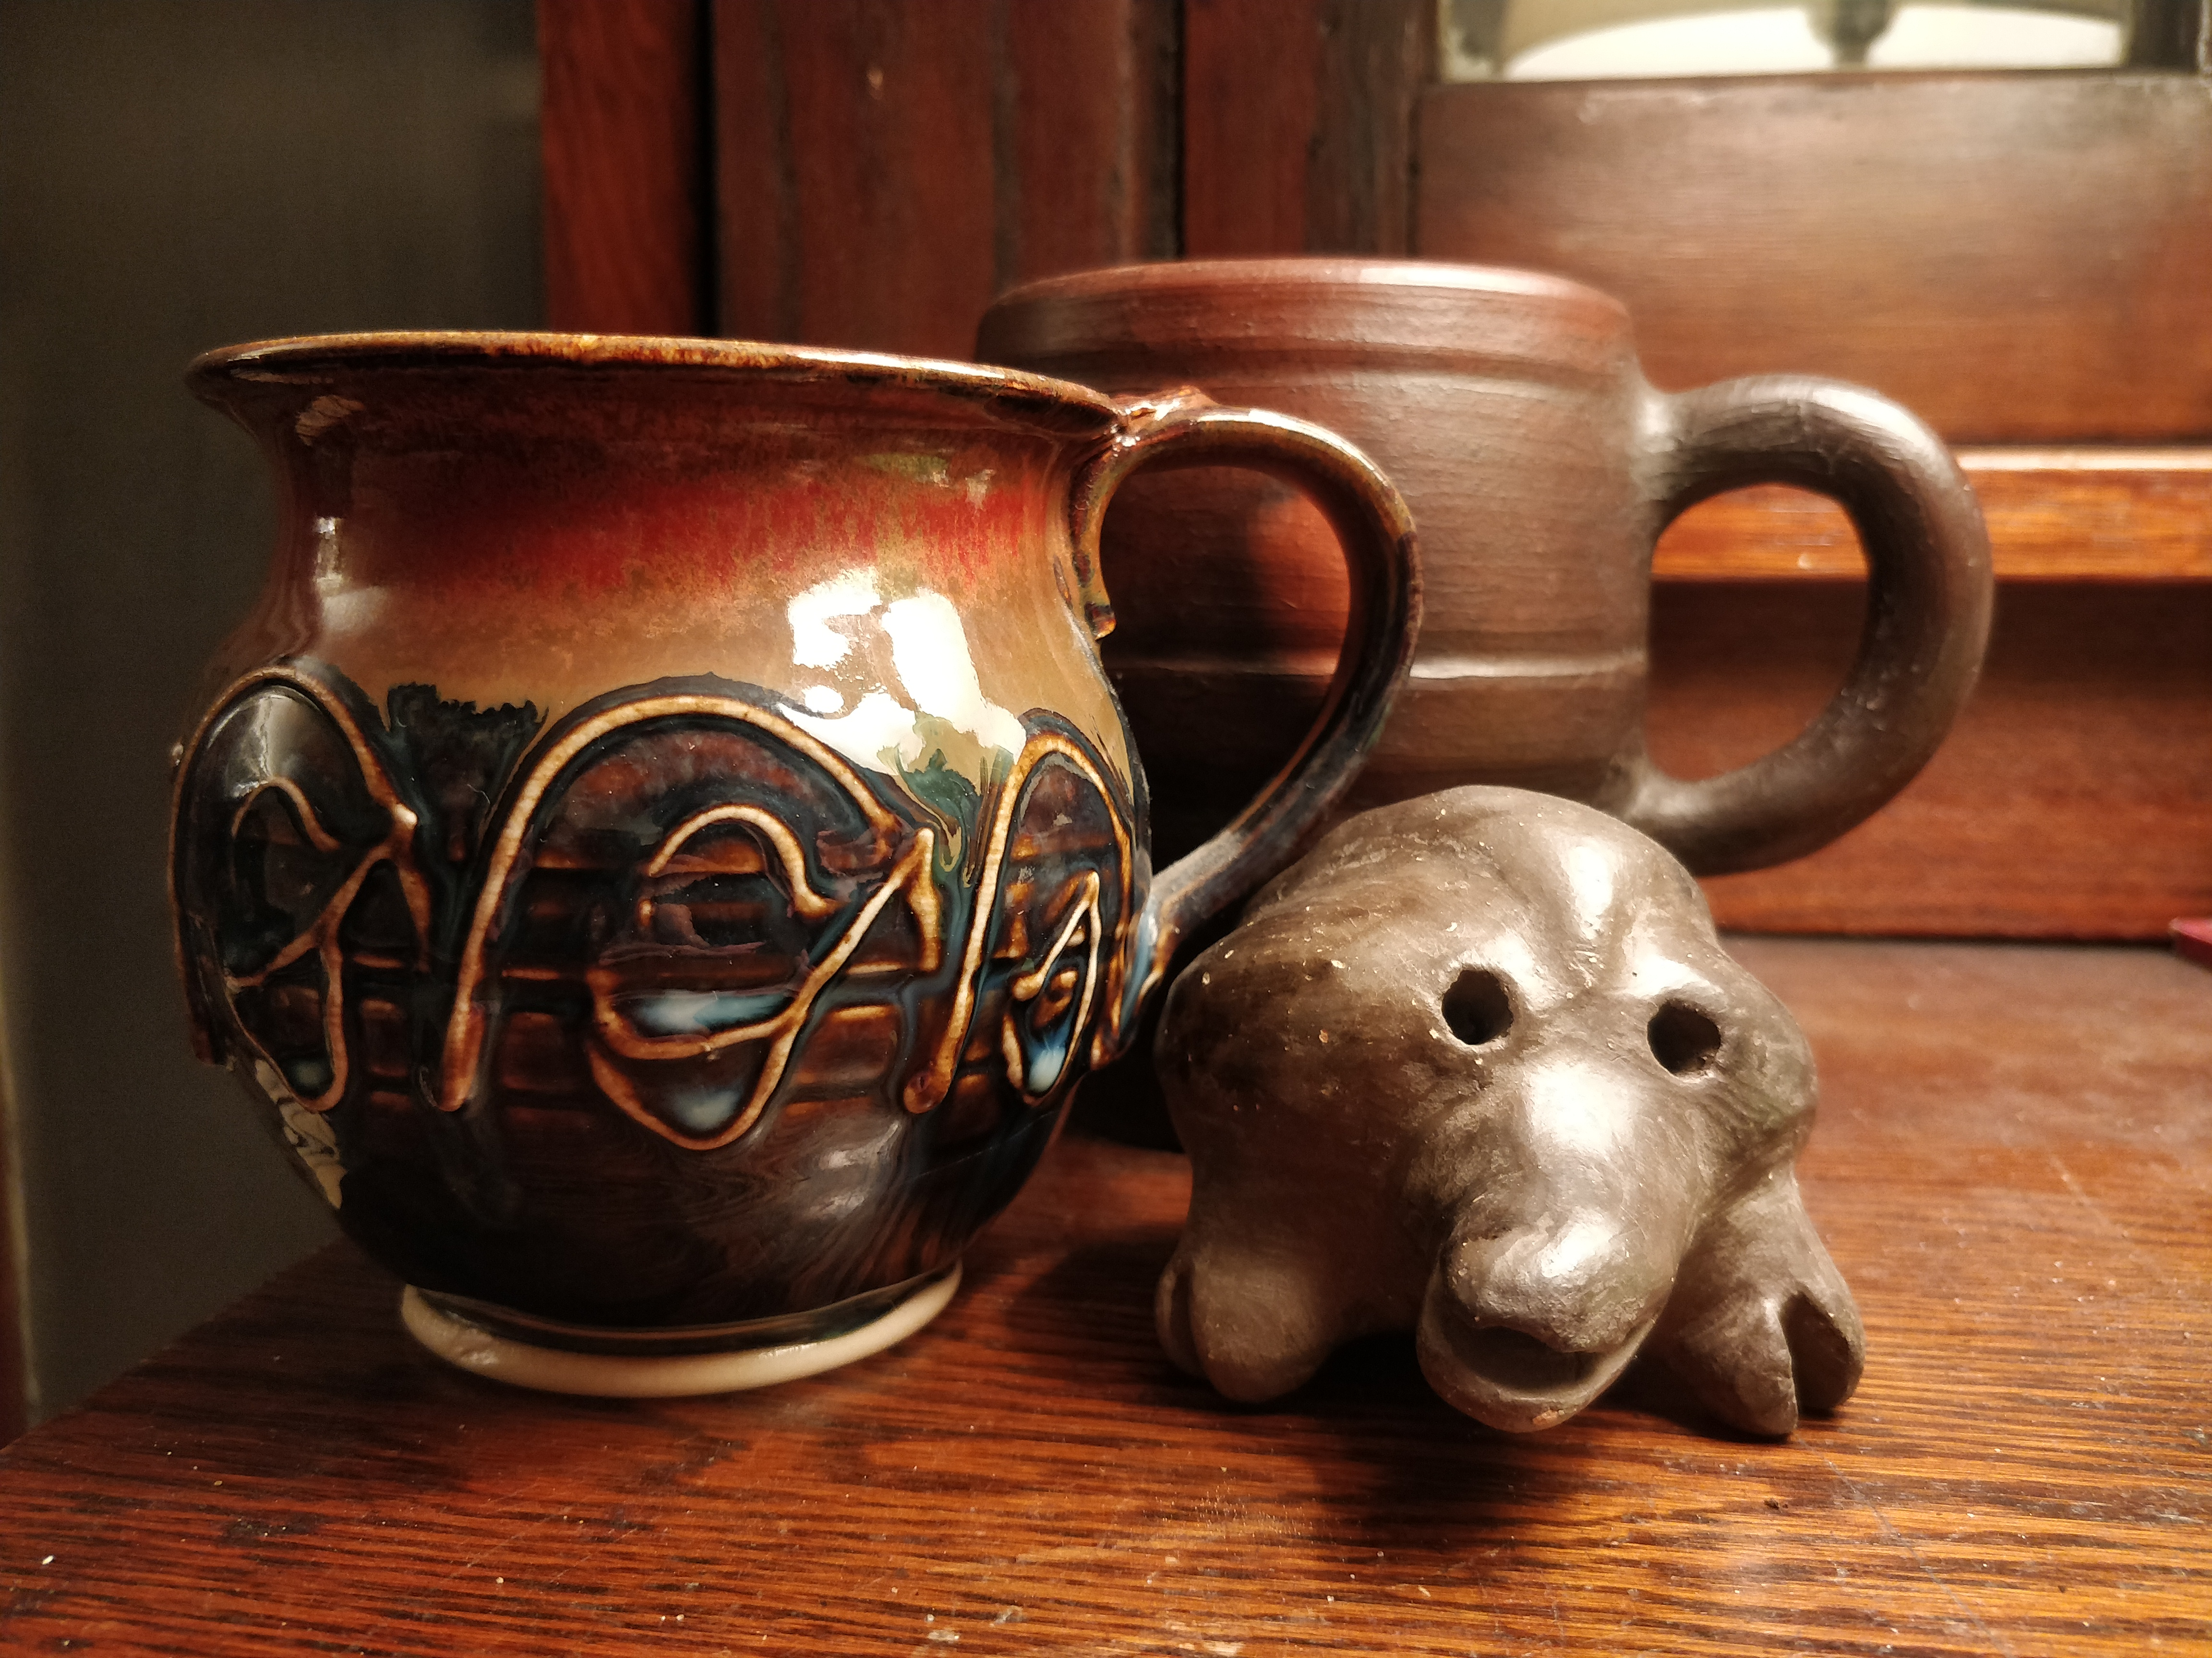
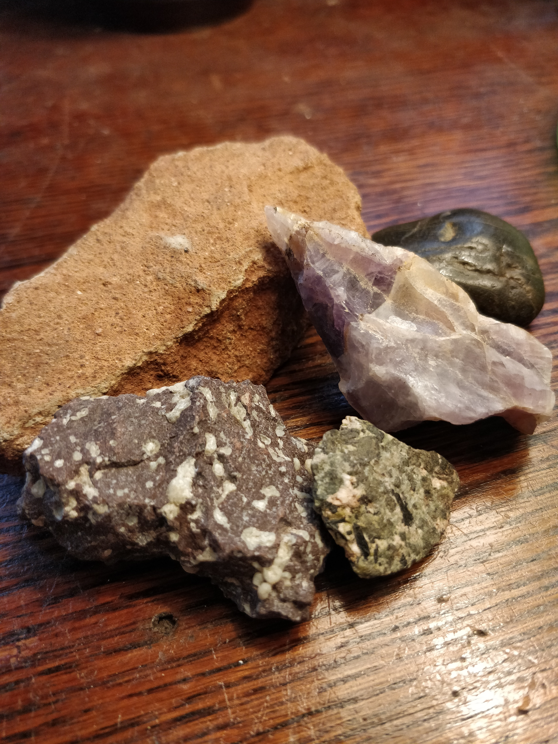
Mugs from Ireland (glazed) and Chile (unglazed) and a friend from Paraguay
A few of my rocks, with representatives from Paraguay (the red), Chile (the green), Canada (the purple), the North Shore (the white-speckled red), and Iowa (the smooth black).
submitted by Justin C.

Slide 10
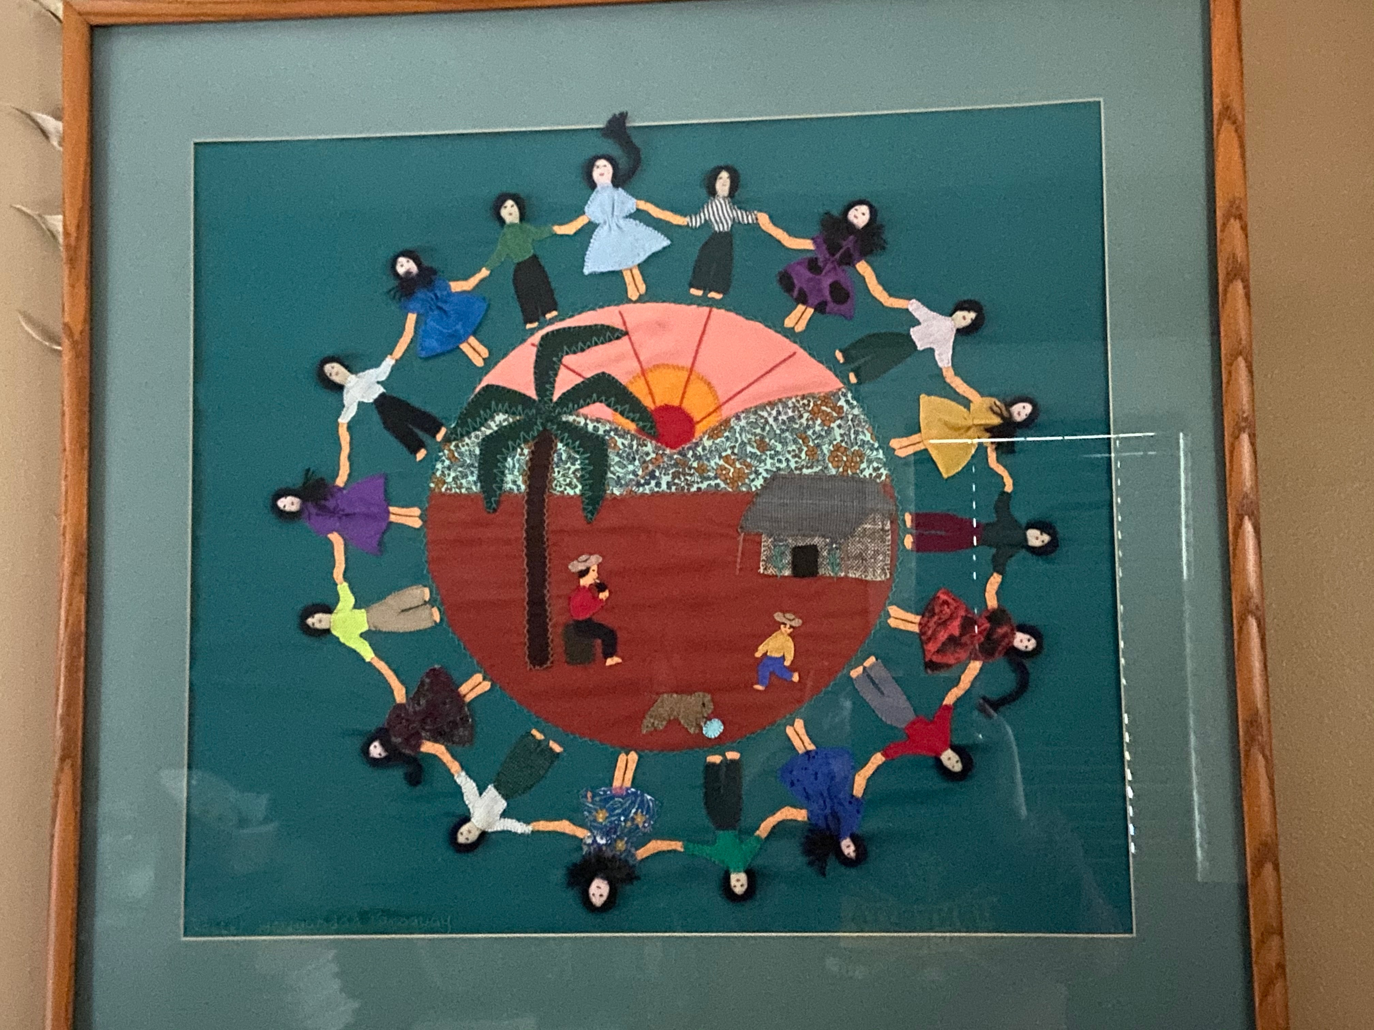
Paraguayanwall hanging created by the women in the Sisterhood Workshop
purchased by Karen B. on her first trip to Paraguay

Slide 11
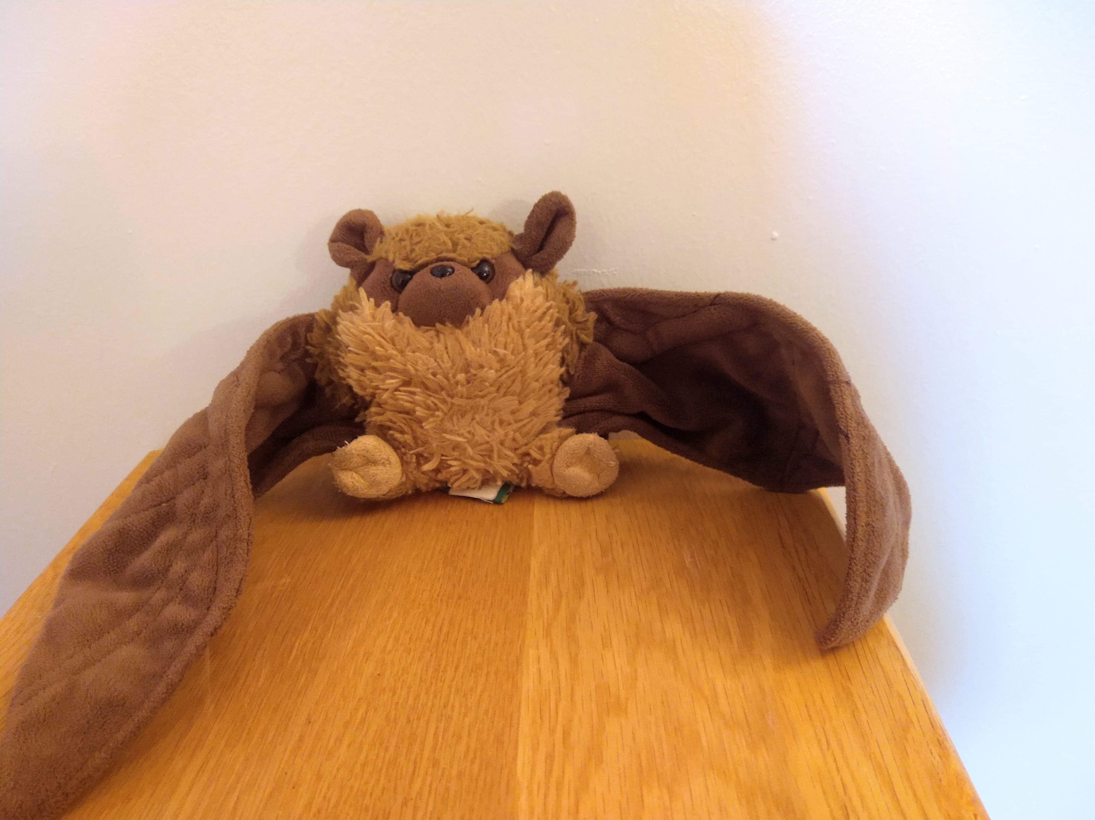
Furry bat
purchased by Mitch G. on his first mission trip to Omaha

Slide 12
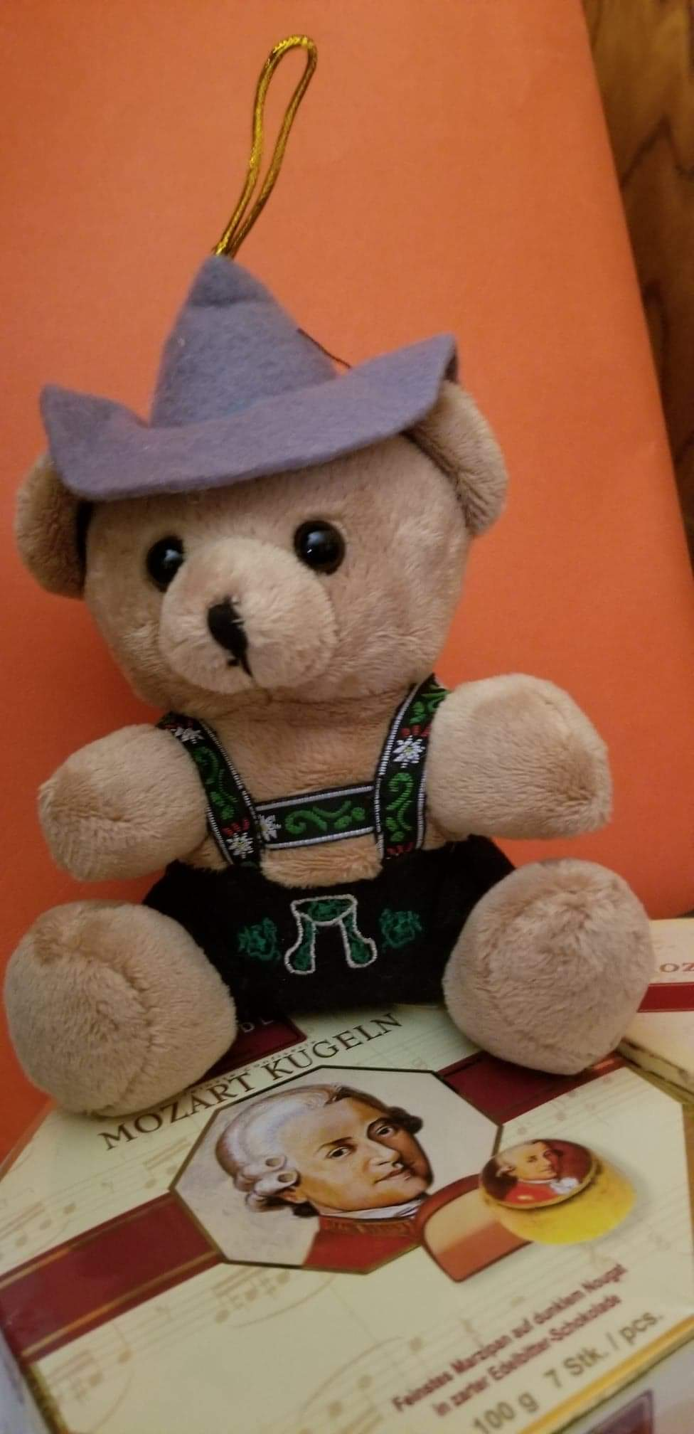
Bärchen
(bear)
purchased by Margaret H. in Vienna, Austria during a visit 10 years ago

Slide 13
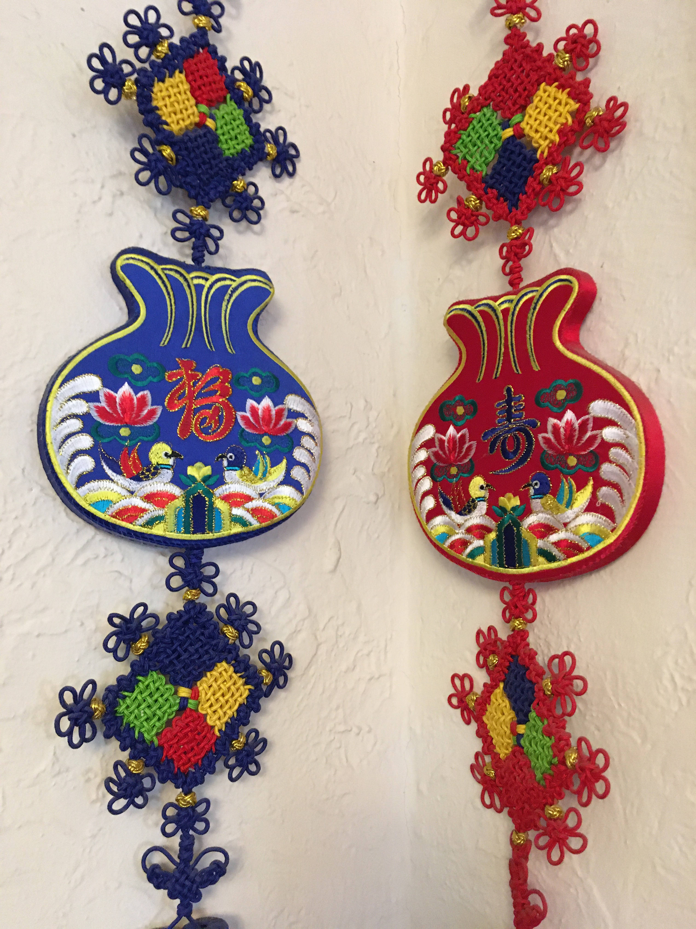
purchased by Melinda N. in Korea

Slide 14
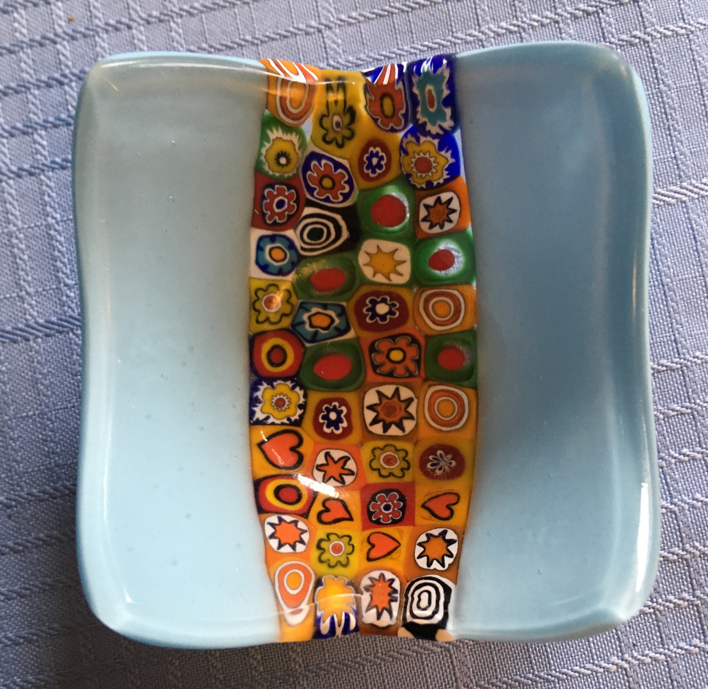
purchased by Kirsten C. in Venice

Slide 15
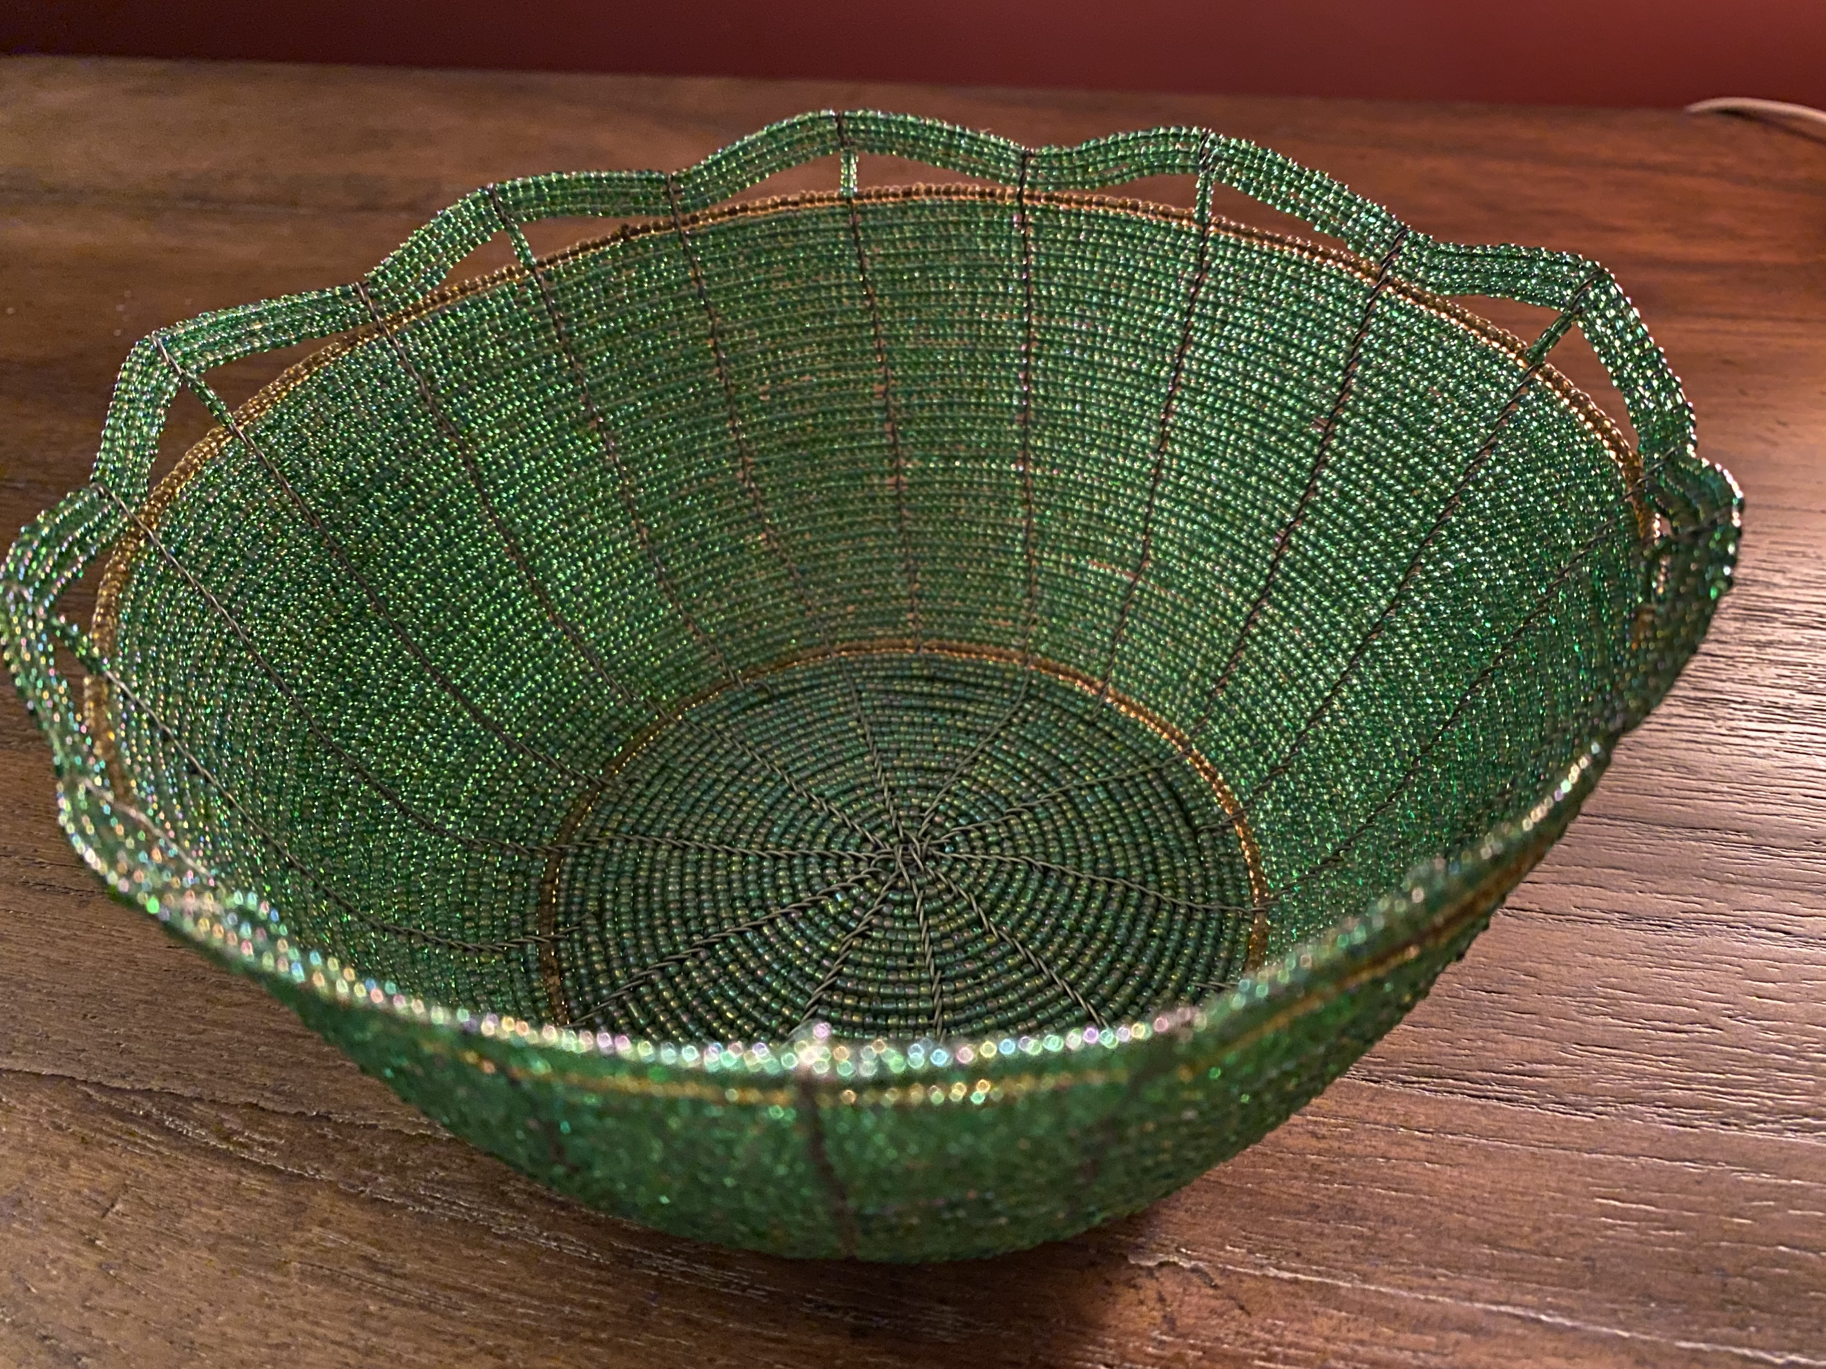
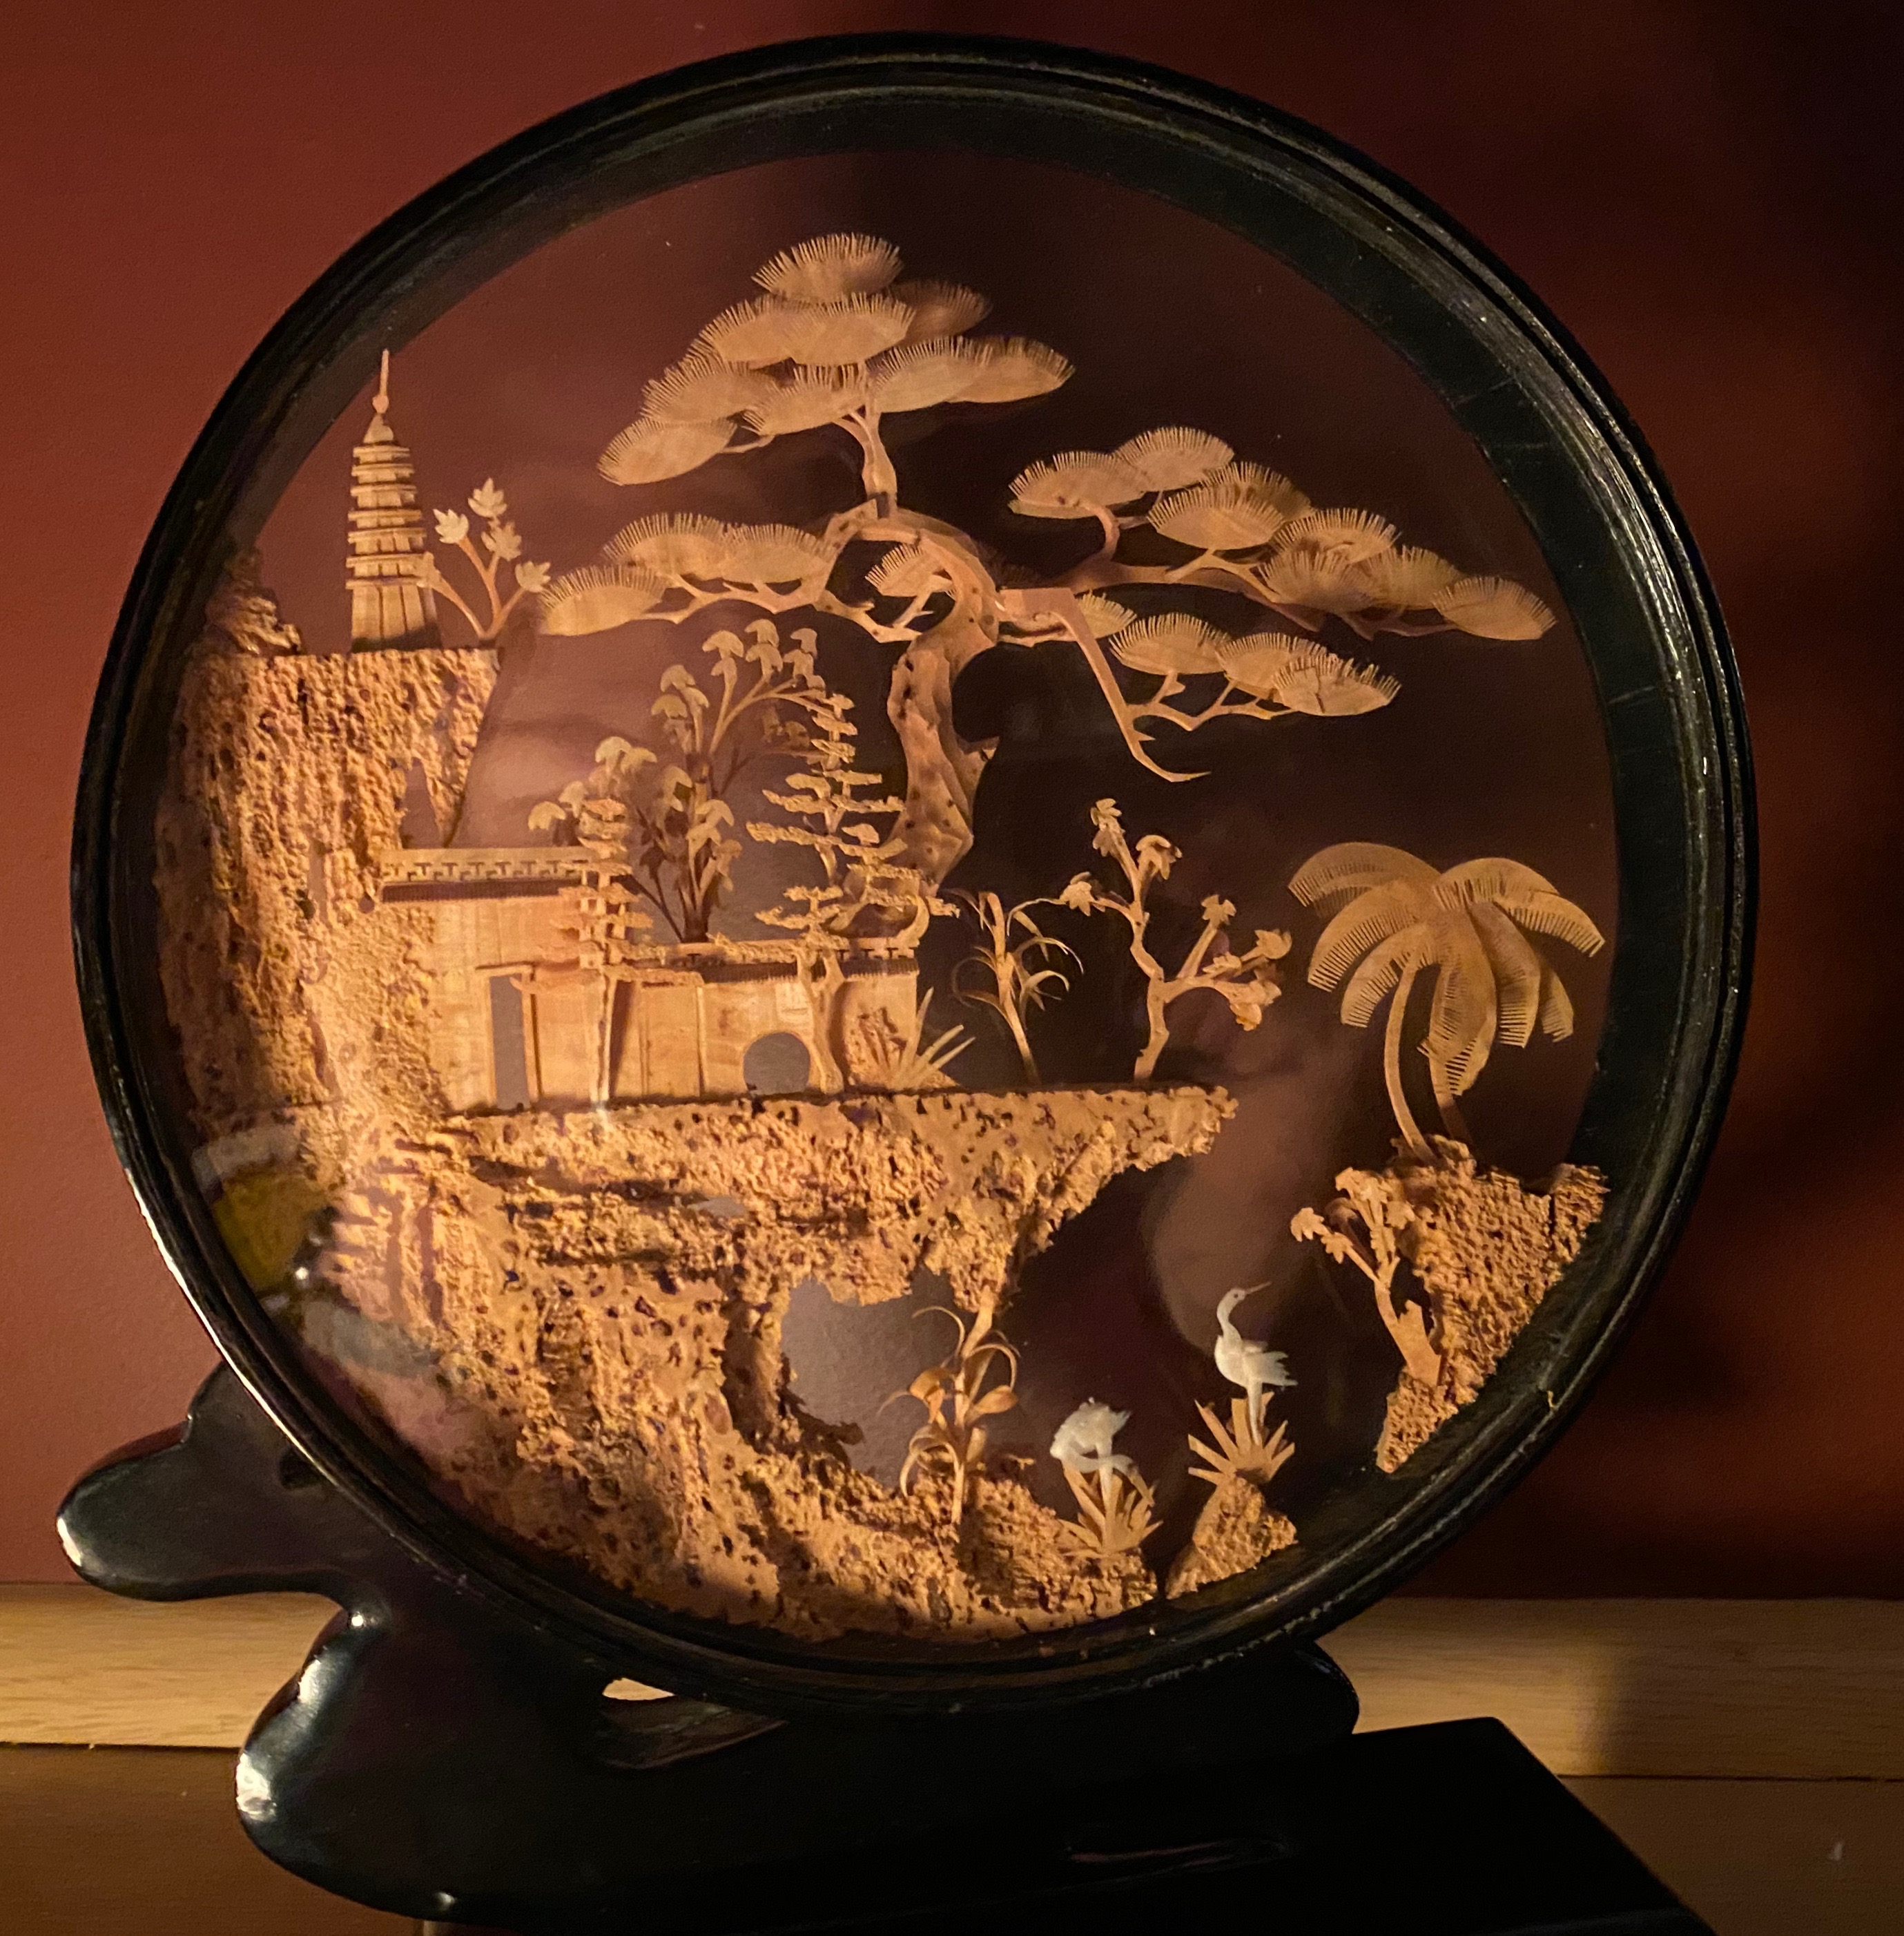
Hand-beaded bowl from Kenya
purchased by Pastor Laurie on a Global Ministries trip
Cork Art from China
purchased by Bryan on a trip to China

